Slide 1
Mobile Safety -Android
03.16.2017

Slide 2
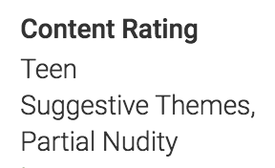
Step 1: Identify reason for maturity rating
“Sex” feature
Step 2: Tag each app based on feature, generate app dataset for each feature
Feature | Violence | Fantasy Violence | Alcohol Drug Tobacco | Sex | Language | Gambling
# Apps | 2347 | 2045 | 184 | 221 | 262 | 1811
Step 3. Generate key word frequency distribution for each feature
Frequency, Normalized Frequency
Step 4. Build lexicon
Ratio
Step 5. Human screening, human adding
Step 6. Testing Lexicon -> suspicious apps

Slide 3
Step 3. Generate key word frequency distribution for each feature
Tokenize, stop word removal
Stemming: PorterStemmer()
Frequency distribution for each feature: FreqDist()
Aggregate word frequency of each feature for every token, calculate total frequency of each token

Slide 4
Step 3. Generate key word frequency distribution for each feature
5. Normalization
Feature | Violence | Fantasy Violence | Alcohol Drug Tobacco | Sex | Language | Gambling
# Apps | 2347 | 2045 | 184 | 221 | 262 | 1811
“Sex”, “Language”, “ADT” has much fewer apps than the other three features.
Normalization
Final Distribution: tokens.xlsx
Notes:
公式

Slide 5
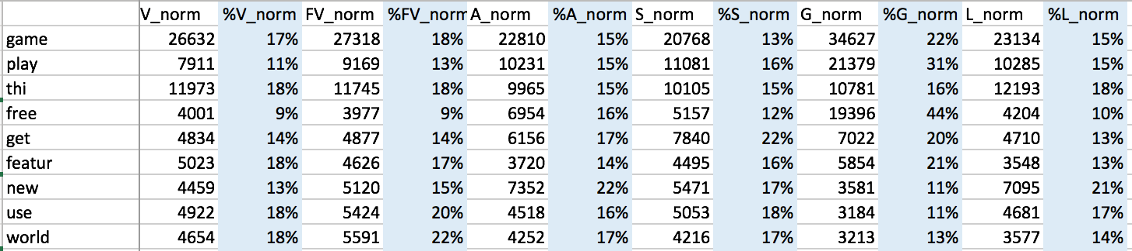
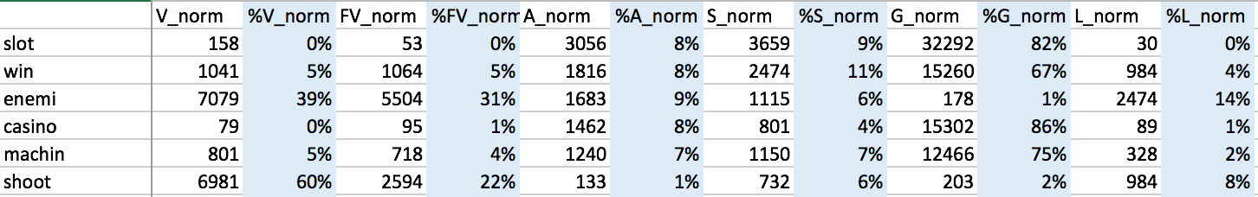
Step 4: Build Lexicon
Equally Distributed words -> Stop words
1) Calculate “Ratio”
For each word:
%V = V_freq / Total_freq
%FV = FV_freq / Total_freq
%A = A_freq / Total_freq
%S = S_freq / Total_freq
%G = G_freq / Total_freq
%L = L_freq / Total_freq
Unequally Distributed words -> Lexicon

Slide 6
Step 4: Build Lexicon
2) Lexicon select rules:
1. Big head: 1 feature distribution > 80%
2. Big head: 2 features distribution > 85%
V + FV > 85% (they are similar)
3. Small tail: 3 features distribution < 5%

Slide 7
Step 5. Human screening, human adding
1) Human expert screening all the lexicon
-Categorize each feature into “Strong list” and “Weak list”
-Delete unreasonable words
-Delete “Language” feature
Top frequency words doesn’t make sense, hard to extract “strong language” content in app description
“Language” feature always come with other feature
2) Human expert add some words into the lexicon
“Sex”, “Alcohol, Drug, Tobacco” features have too few words, so add some words
Add “Direct warning” feature: “for adults”, “21 years older”
Final Lexicon: Lexicon.xlsx

Slide 8
Step 6: Testing Lexicon -> Suspicious apps
Combine all “Strong list” into “Strong word list”
Identify strong words in each app description
Look at “Everyone” level
It shouldn’t contain any Strong Words!!
Strong word list = Violence_Strong + Sex_Strong + ADT_Strong + Gambling_Strong + DirectWarning_Strong

Slide 9

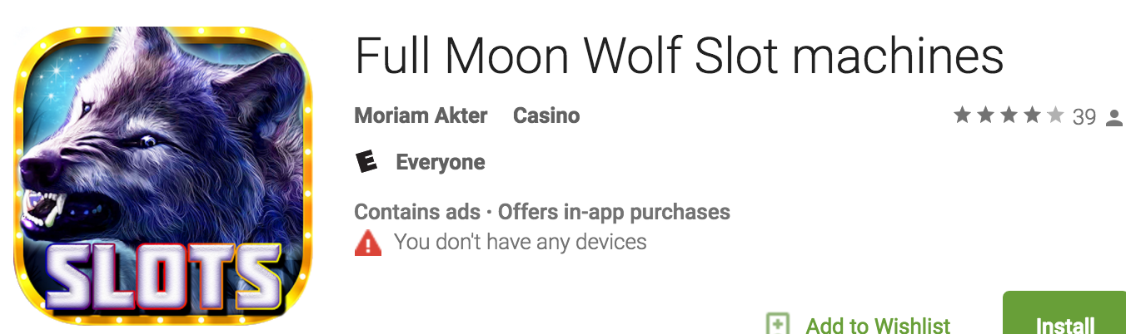
Suspicious app 1
8 Strong words!

Slide 10
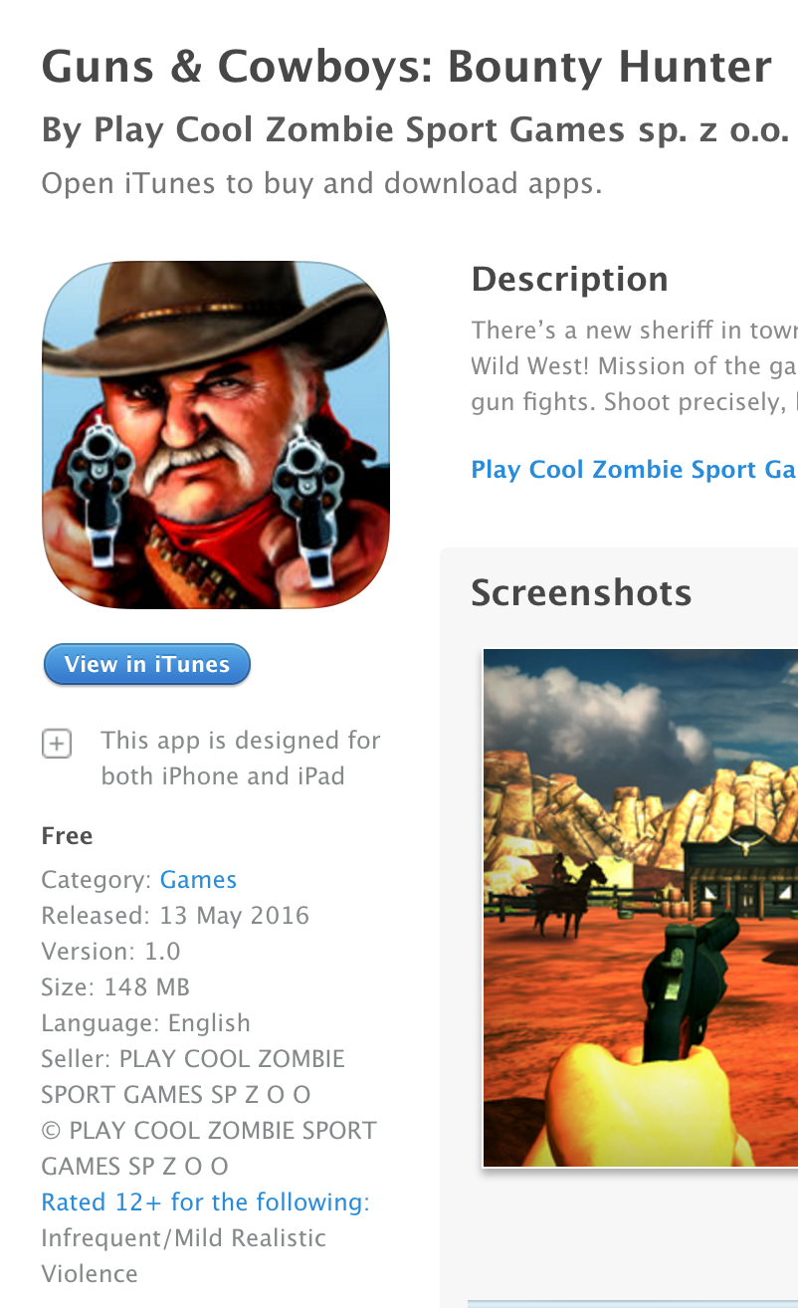
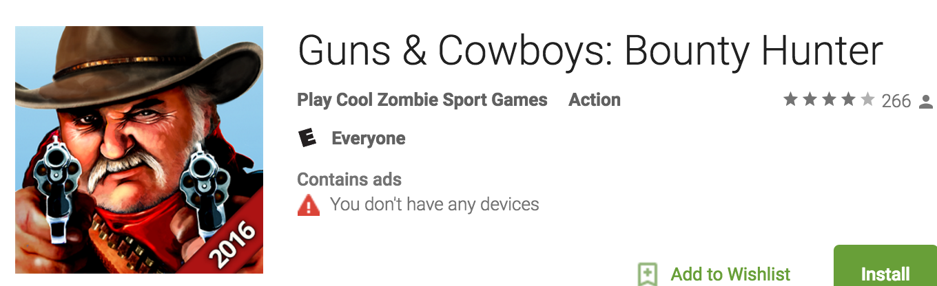

Suspicious app 2
iOS:
Android:
9 Strong words!

Slide 11
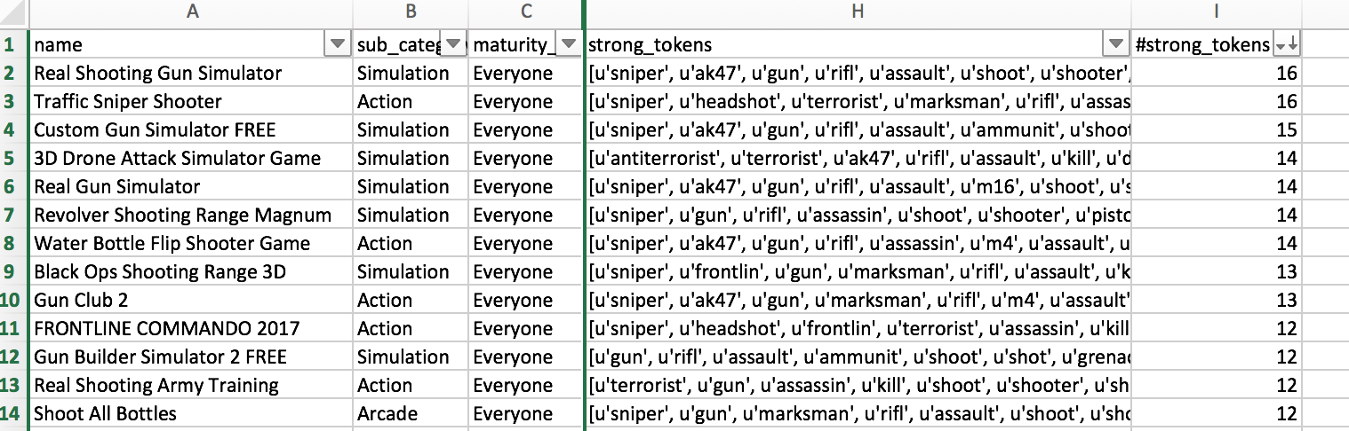
Suspicious apps in “Everyone” level
Suspicious_app_0314.xlsx
28,974 “Everyone” apps
Num of strong words in the app | 1 | 2 | 3 | 4 | 5 | 6 | 7 | 8 | 9 | 10 | 11 | 12 | 13 | 14 | 15 | 16 | Grand Total
Num of apps | 5528 | 1595 | 632 | 200 | 67 | 39 | 23 | 17 | 10 | 3 | 7 | 8 | 2 | 4 | 1 | 2 | 8138
54 apps: has more than 8 strong words in their description
1015 apps: has more than 3 strong words in their description

Slide 12
Next step:
Strong word list – Absolute method
Similarity – Relative method

